Slide 1
Dendrite regeneration
Jongyoon Sohn

Slide 2
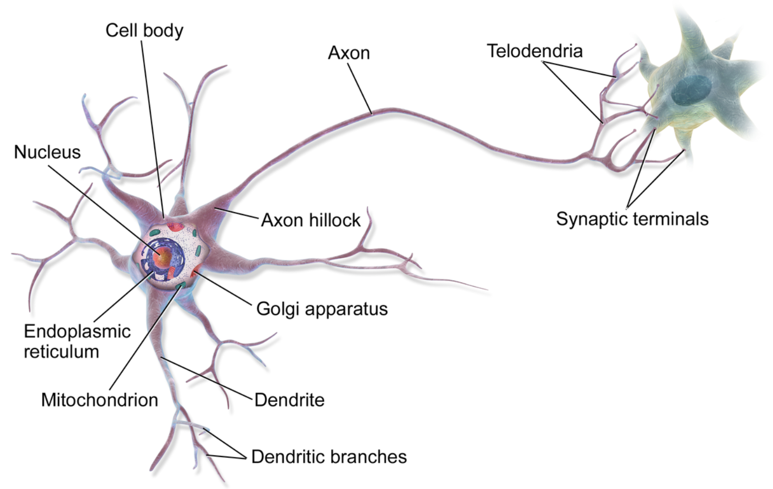
Background
Neurons = Dendrite + Axon
Regeneration needs to perform their roles
Notes:
Most neurons consist of a dendrite compartment and an axon compartment and they must survive to perform their functions.
Richard’s interested in the regeneration of dendrites when damages are given to them.

Slide 3
Background
wild type regeneration
vs
Ror26 regeneration
Notes:
He set this experiment where a transgenic larva is put on a microscope slide and he cut out dendrites with a laser and imaged the same neurons after 48 hours to assess regeneration. The largest diameter of dendrites is measured.
He found out that the dendrite phenotype with Ror ∆26 is distributed non-typically in that some have typical regeneration diameters while there exists an increase in number of observations which have non-typical regeneration diameters along with a designated cutoff of 75µm.

Slide 4
Research question
Are the regeneration diameters in ror26 obtaining non-typical diameters less than 75𝜇𝐦 and significantly different from regeneration diameters in wild type?
=> Are the regeneration diameters in ror26 drawn from the same distribution with regeneration diameters in wild type? If yes, how to cluster observations in ror26?
Notes:
So his research question is that ~.
I needed to figure out first that the distribution of regeneration diameters of Ror26 is different from that of wild type. If yes, I should find out a way to cluster observations in Ror26.

Slide 5
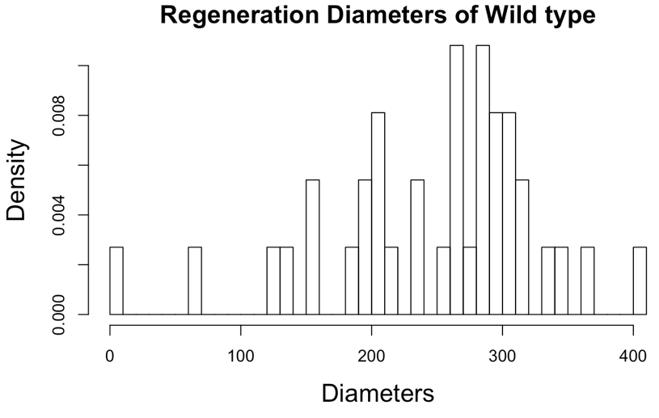
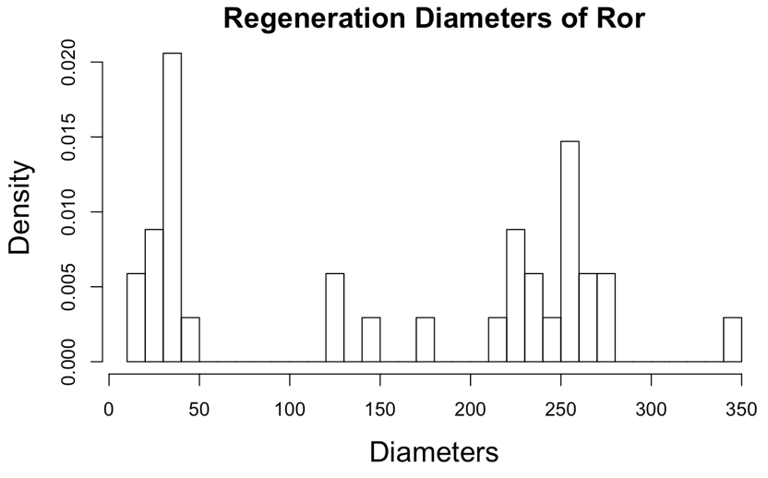
eda
Notes:
Here’s some explanatory data analysis results.
The first graph is the histogram of regeneration diameters of wild type. You might want to say that it seems to be normally distributed even though it’s skewed a little to the left.
The second one is the histogram of regeneration diameters of ror. As you can see, there is an increase in number of observations less than, say 50, which makes them non-typical.

Slide 6
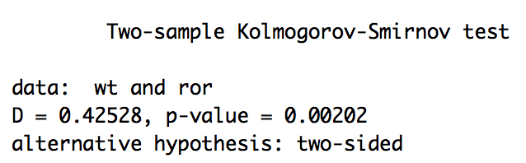
Kolmogorov-smirnov test(K-s test)
Conclusion:
regeneration diameters of two types are significantly different from each other.
Notes:
To figure out if it is true that regeneration diameters that result from two types of genes are actually different from each other, the Kolmogorov-Smirnov test (K-S test) was applied.
The K-S test is a nonparametric test that can be used to compare a sample with a reference distribution and provides a statistic that indicates the difference between empirical distribution function of a sample and cumulative distribution function of the reference function.

Slide 7
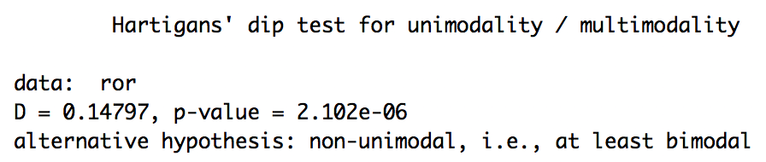
The Dip test
Conclusion:
more than one mode exists in the distribution of regeneration diameters in ror26.
Notes:
In the previous slide, we’ve seen that the histogram of regeneration diameters of ror looks to have more than one mode so I applied the dip test to see if my guess is true.
The dip test is to test if the distribution is multimodal. The p-value less than .05 tells that the distribution of regeneration diameters of ror has more than one mode.

Slide 8
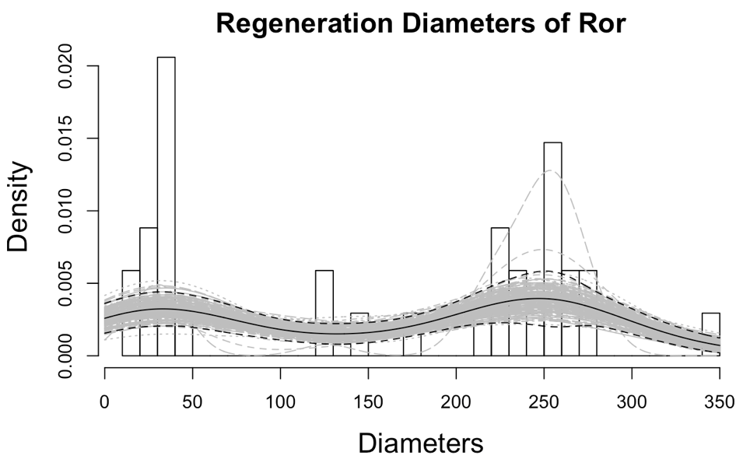
Kernel density function
Conclusion:
The distribution of regeneration diameters in ror25 has two modes.
Notes:
Given that we know that the ror has more than one mode, I wanted to find out how many are there.
The nonparametric bootstrap technique is used to determine how many modes exist. In order to obtain the best candidate for kernel density, samples were drawn with replacement 200 times and fitted accordingly. The straight line is the mean of 200 sample sets and the dashed lines indicate 2 standard deviations from the mean.
So, now it turns out that the distribution of regeneration diameters of ror actually has two modes in it.

Slide 9
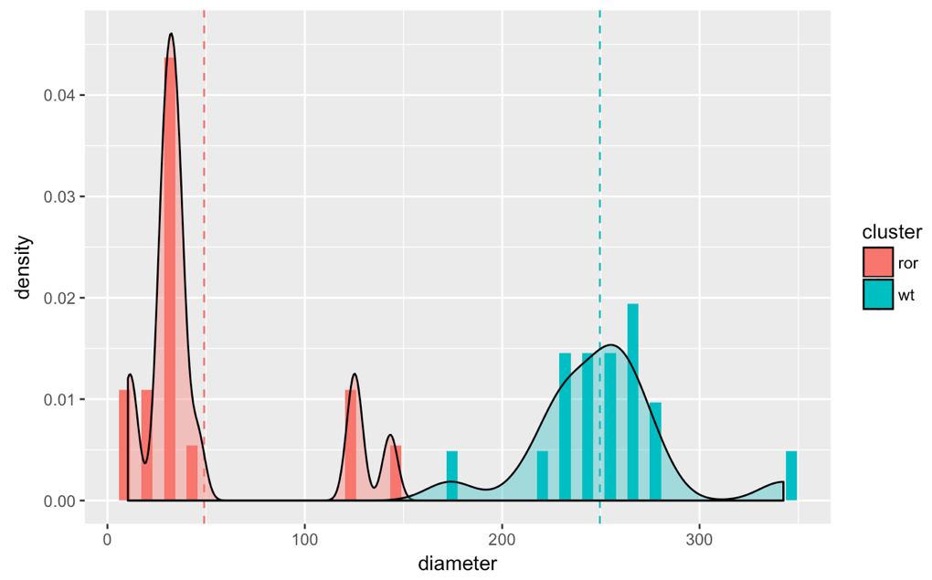
K-means clustering
Conclusion:
Two clusters can be divided based on a cutoff of 150, which is the average of two cluster means.
Notes:
Richard wanted to know the cutoff of diameter at which he knows how to cluster two groups.
The K-Means clustering technique is used to cluster. This method basically takes distances from cluster means into consideration. It gives one cluster with mean of 49 and the other cluster with mean of 250 and the cutoff of 150, which is the mean of two cluster means.

Slide 10
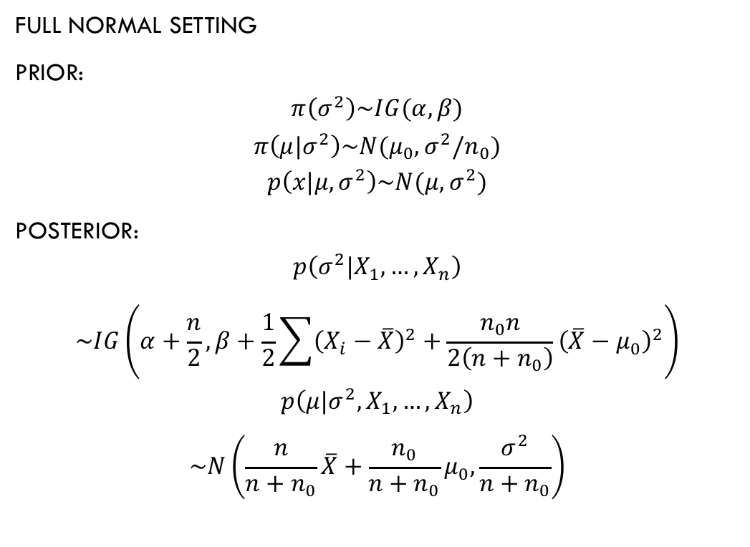
Bayesian inference
full normal setting
prior:
$$π\left(σ^{2}\right)\sim IG(α,β)$$
$$π\left(μ|σ^{2}\right)\sim N(μ_{0},σ^{2}/n_{0})$$
$$p\left(x|μ,σ^{2}\right)\sim N(μ,σ^{2})$$
posterior:
$$p\left(σ^{2}|X_{1},…,X_{n}\right)$$
$$\sim IG\left(α+\frac{n}{2},β+\frac{1}{2}\sum{{\left(X_{i}−\overline{X}\right)}^{2}}+\frac{n_{0}n}{2\left(n+n_{0}\right)}{\left(\overline{X}−μ_{0}\right)}^{2}\right)$$
$$p\left(μ|σ^{2},X_{1},…,X_{n}\right)$$
$$\sim N\left(\frac{n}{n+n_{0}}\overline{X}+\frac{n_{0}}{n+n_{0}}μ_{0},\frac{σ^{2}}{n+n_{0}}\right)$$
Notes:
Second way to cluster into two groups is to use a reference distribution function.
In the EDA slide, the histogram of wild type looks approximately normal so I assumed the distribution of wild type is actually normal and consider it as the reference function. In order to fit the reference distribution, the basic concept of the Bayesian inference was used.

Slide 11
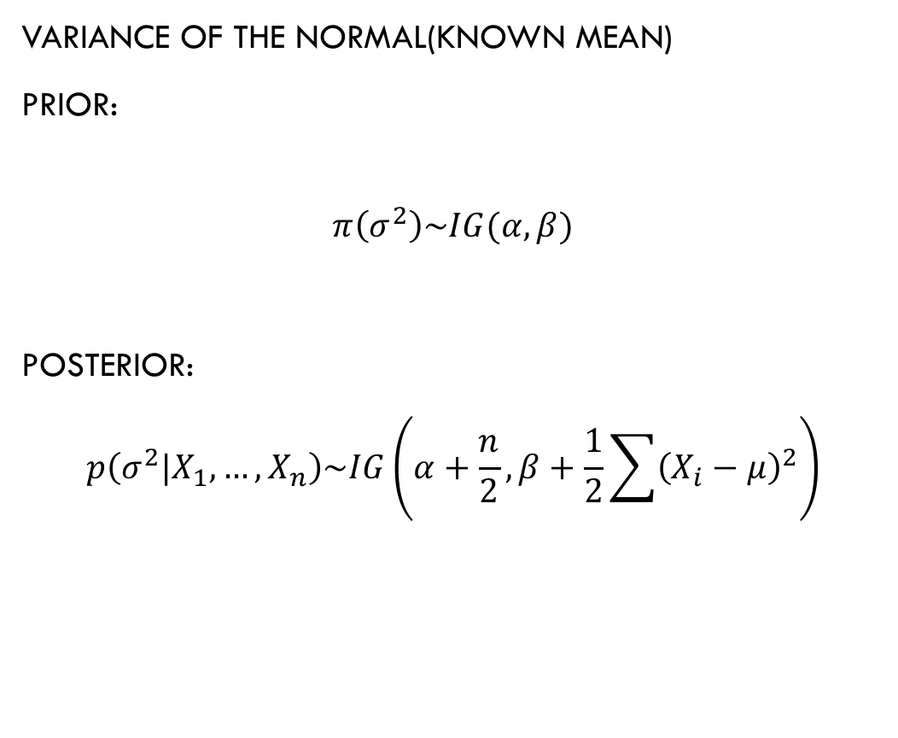
Bayesian inference
variance of the normal(known mean)
prior:
$$π\left(σ^{2}\right)\sim IG(α,β)$$
posterior:
$$p\left(σ^{2}|X_{1},…,X_{n}\right)\sim IG\left(α+\frac{n}{2},β+\frac{1}{2}\sum{{\left(X_{i}−μ\right)}^{2}}\right)$$

Slide 12
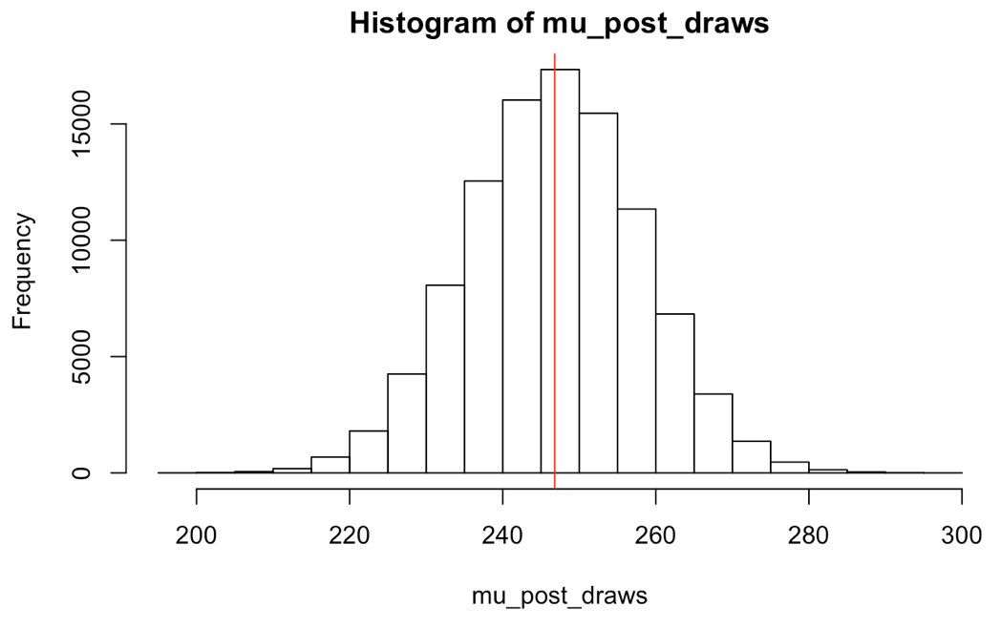
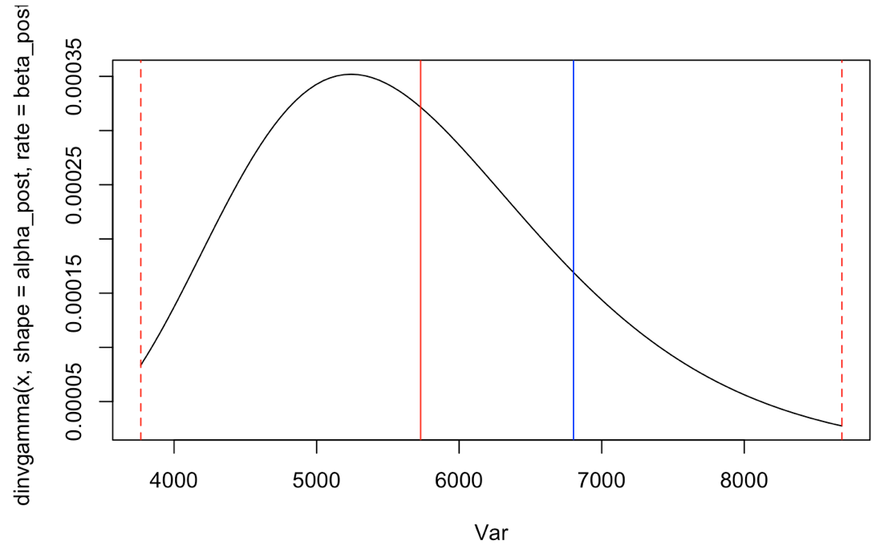
Bayesian inference

Slide 13
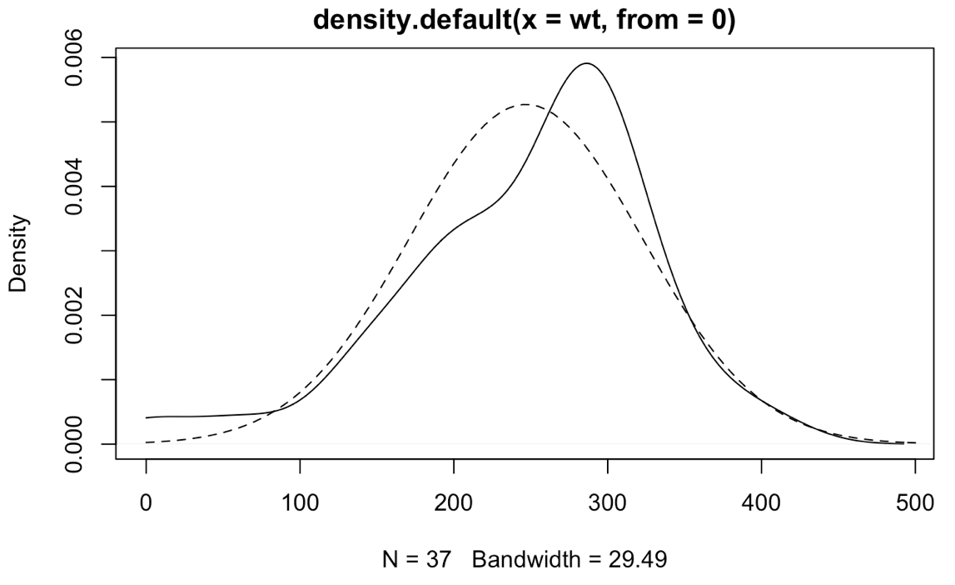
Bayesian inference
Notes:
The straight line is the kernel density for the raw data of Wild type and the dashed line represents the best fitted kernel density of Gaussian since we assumed that the true distribution is Gaussian. The two density functions share 80.58% of area.

Slide 14
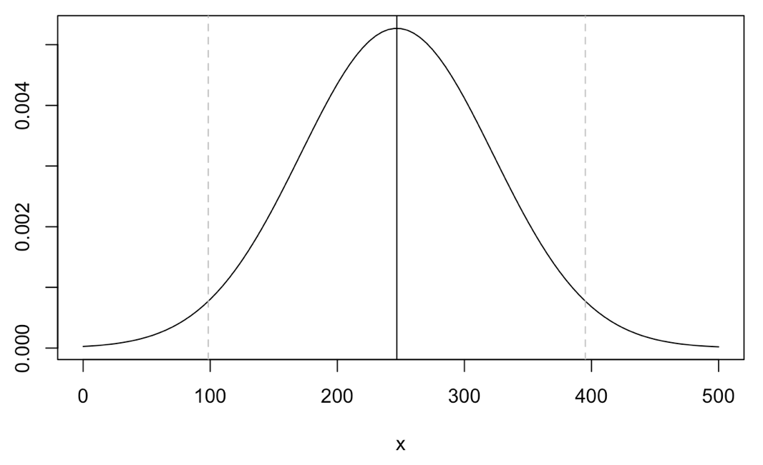
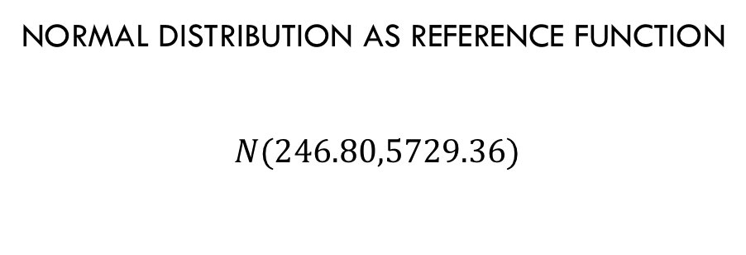
Bayesian inference
Normal distribution as reference function
$$N(246.80,5729.36)$$
Notes:
95% of observations in $N(246.80,5729.36)$ will be seen within dashed lines(at 98.45 µm and 395.16 µm respectively).

Slide 15
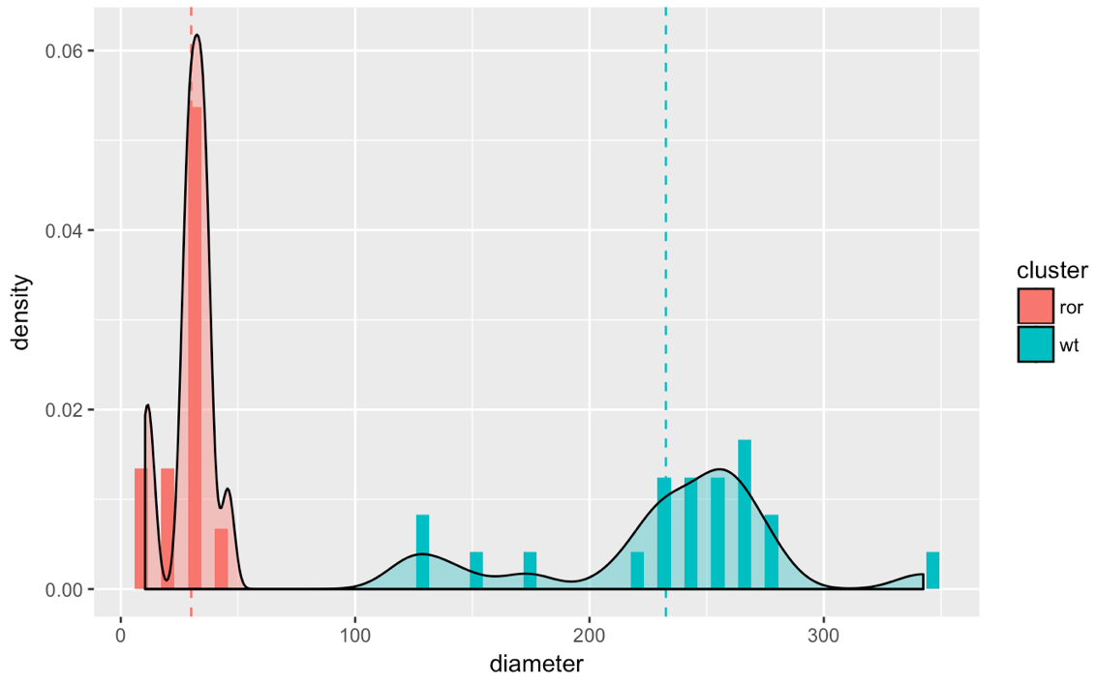
Bayesian inference
Conclusion:
Two clusters can be divided based on a cutoff of 98.45, which is the 2.5% quantile of n(246.80,5729.36)
Notes:
The cutoff of 98.45 is the 2.5% quantile of Gaussian distribution,$N(246.80,5729.36)$ and if there exist observations less than 98.45, they should be considered as non-typical regeneration diameters.

Slide 16
recommendation
K-means clustering can be misleading the result because it clusters based on only one sample set and the technique produces clusters based on distance between observations and cluster mean.
An assumption of Gaussian distribution was given when fitting a model for Wild type using the Bayesian inference. Therefore, if this assumption is violated in the real data, it may lead to a wrong conclusion.
All the analysis above is conducted based on the same data set so analysis results may differ depending on the size of sample and different sets of data that would be used in the analysis. It would be recommended to repeat the same methods multiple times using many different sample sets to get a more reasonable result.

Slide 17

Q & a

Slide 18
Thank you

